Slide 1
Why learn the basics
when AI can write code?
CSE-1003 · FUNDAMENTALS OF COMPUTER PROGRAMMING
Class 1 · B.Tech First Year · IIIT Bhopal
Dr. Sachin DN · Department of CSE
Notes:
Have the Mentimeter QR code ready on the next slide. Walk in, smile, and keep this slide up while students settle. Don't explain the title yet; the question on it is what the whole class is about.

Slide 2
A little about me
Sachin D N
STUDIED
RESEARCH ABROAD
PhD, NITK Surathkal
Postdoc in Norway (NTNU)
WHAT I WORK ON
NOW
Federated Learning, AI for Healthcare, Edge and Distrubuted Computing.
Assistant Professor, CSE, IIIT Bhopal
Notes:
Two minutes maximum. The point is credibility, not a CV reading. One line that lands well: everything I built in my research runs on code, and debugging it needed exactly the basics we'll learn here.

Slide 3

The AI learns from data. Code makes the learning possible.
FROM MY RESEARCH
The model learns to find the tumour from thousands of labelled scans. Code loads every scan, runs the training loop and checks every prediction. One wrong line, like a flipped left-right axis, and the AI learns the wrong thing.
for epoch in range(100):
for scans, masks in train_data:
pred = model(scans)
loss = dice_loss(pred, masks)
loss.backward(); optimizer.step()
Region the AI marked as tumour
Illustration, not a real patient scan
Notes:
Be honest about how AI works: nobody wrote if-else rules to find the tumour. The model learned that from labelled scans. But code surrounds the learning at every step. The training itself is a loop: for every epoch, for every batch, predict, compute the loss, update the weights. That's Module 2 inside AI. Code also prepares the data (loading, resampling, normalizing intensities, matching each scan to its label) and checks the output (Dice scores, thresholds). Share one real bug from your own work here, like a flipped axis or a normalization that differed between training and inference: the model trained "fine" and the results quietly went wrong. That's the integer-division bug again, at a much bigger scale. You can swap the illustration for a real, de-identified image from your own work.

Slide 4
Go to menti.com
Notes:
Replace the code placeholder and drop in the QR image from Mentimeter. Leave this up for a minute; most students will join while you finish speaking. Keep a show-of-hands backup in case the Wi-Fi fails.

Slide 5
"AI will make learning programming unnecessary."
Agree or disagree?.
Notes:
Switch to the Q4 result in Mentimeter. Ask two or three students from each side to explain their vote. Don't argue yet; just listen and thank them. This is the bridge to the next slides, and it means the students raised the AI question, not you.

Slide 6
I am a computer.
Teach me to make chai.
MENTIMETER ACTIVITY
Computers do exactly what you say, not what you mean.
Notes:
Mentimeter setup: an Open Ended question, "I am a computer. Write step-by-step instructions to make chai." Turn on multiple submissions per person if you want students to send one step at a time. Give them 2 minutes to type. Then pick 3 or 4 answers from the screen and act them out literally. "Add milk": pour it without opening the packet (mime it). "Boil water": ask where the water is, which vessel, is the stove on? "Add sugar": ask how much. Point out what each answer assumed. Answers usually range from "make tea" to a careful 10-step list; compare them. Then click to reveal the punchline at the bottom: that is programming. When AI writes code, someone still has to check the instructions are exactly right. Keep the results: you can bring them back when you teach algorithms and flowcharts.

Slide 7
Which is the second largest number?
HOW YOUR BRAIN DOES IT
5
13
15
7
6
You answered in under a second. Your eyes saw all five numbers at once, and your brain just knew: 13.
Notes:
Ask the class to shout the answer. Everyone says 13 almost instantly. Then click to reveal the line at the bottom. Ask: how did you do it? Nobody can explain the steps; the brain looks at everything in parallel and handles its own temporary memory without being told.

Slide 8
The CPU is blind, like Dhritarashtra
HOW THE CPU DOES IT
5
?
?
?
?
It sees only one number at a time, as Sanjay (the program) reveals it. To remember anything, it needs boxes in memory: variables.
?
?
largest
second_largest
Notes:
The Dhritarashtra analogy: Dhritarashtra could not see the battlefield; Sanjay described it to him one event at a time. The CPU is the same. It cannot glance at all five numbers. It reads one, compares it using > or <, and must store whatever it needs to remember in variables. Optional: do this physically with five coins or cards face down, turning over one at a time, so students feel what it is like to be the CPU.

Slide 9
Thinking like a CPU, one step at a time
Step
Reads
Decision
largest
second_largest
1
5
First number
5
0
2
13
13 > 5: copy 5 down, then store 13
13
5
3
15
15 > 13: copy 13 down first, then store 15
15
13
4
7
Smaller than both: do nothing
15
13
5
6
Smaller than both: do nothing
15
13
At step 3, if you store 15 first, the 13 is erased from memory forever.
Notes:
Reveal one row per click and ask the class what the CPU should do before each reveal. Slow down at step 3, the critical step: you must copy the old largest (13) into second_largest before overwriting largest with 15. Ask: what happens if we do it the other way round? Answer: 13 is lost, and the program prints the wrong answer. This is exactly the kind of order-of-steps thinking that coding needs.

Slide 10
Write it down: the algorithm
Plain language · no code yet
1
Create two boxes in memory: largest and second_largest.
2
Put the first number in largest.
3
Read the next number. If it is bigger than largest: first copy largest into second_largest, then store the new number in largest.
4
Otherwise, if it is bigger than second_largest, store it there.
5
Repeat step 3 until no numbers are left. Then print second_largest.
Notes:
An algorithm is just clear, step-by-step logic in plain language: English, Hindi or any language. Point out the link to Module 1: this is exactly what algorithms, flowcharts and pseudocode are for. Ask a student to read step 3 aloud and check it against the trace table.

Slide 11
Same steps, strict syntax
int nums[] = {5, 13, 15, 7, 6};
int largest = nums[0], second = 0;
for (int i = 1; i < 5; i++) {
if (nums[i] > largest) {
second = largest; // copy first!
largest = nums[i];
} else if (nums[i] > second) {
second = nums[i];
}}
}}
printf("Second largest: %d", second);
THE PROGRAM
Each line is one step of the algorithm, written in C. Output: Second largest: 13
Don't worry about the syntax yet. You'll write this yourself by Module 4.
Notes:
Point at each part and match it to the algorithm: two variables = the two boxes; the for loop = repeat until no numbers are left; the if = bigger than largest, copy first; the else if = bigger than second. Run it live if you like (it is tested and prints 13). Note for later: starting second at 0 only works for positive numbers; a good improvement to discuss in Module 4.

Slide 12

99% thinking.
1% typing.
1 · THINK
2 · ALGORITHM
3 · PROGRAM
Understand the problem like a brain
Break it into steps a CPU can follow
Write those steps in C
Notes:
The key message: coding is mostly logical thinking; typing the syntax is the small part. AI can help with the 1%, but the 99% is yours. If a student asks "why not just sort the numbers?", use the chef analogy: using a built-in sort in an interview is like entering India's Best Chef with ready-made spice packets. Interviewers want to see your logic, and a single pass through the numbers is also faster than sorting.

Slide 13
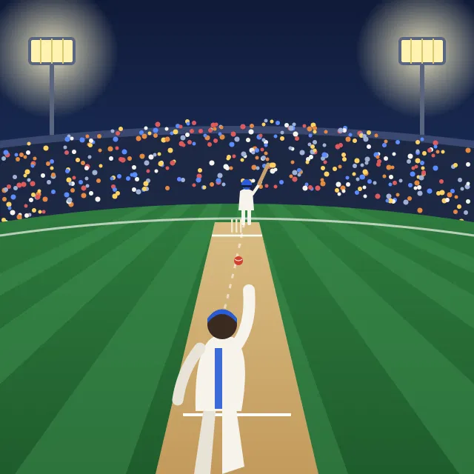
Ever watched cricket without knowing the rules?
Without the basics
With the basics
People running, the crowd cheering
No idea why the umpire gave LBW
DRS overturned it? Confusing
You see why the captain moved slip
You can judge the LBW call yourself
You can explain what went wrong
Notes:
Ask: who here has watched IPL with someone who doesn't know cricket? What did they ask you? Then make the point: the commentator, coach and selector watch the same match as a newcomer, but understand it completely differently. Same with AI-written code.

Slide 14


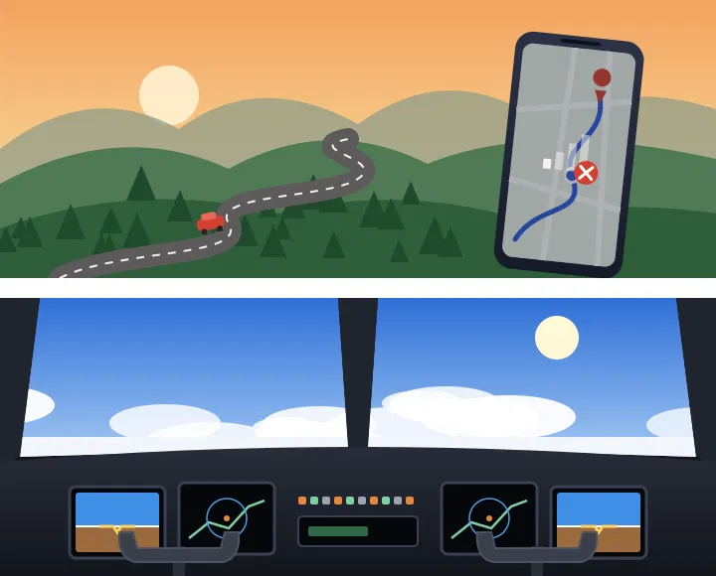
The tool works until it doesn't
Google Maps
Pilots and autopilot
It gets you anywhere, until the network drops on a ghat road. Then only people who know the roads get home.
Planes fly on autopilot most of the time. Pilots still train hard to fly by hand, because when something fails, a human takes over.
Notes:
Use these quickly, as support for the cricket analogy, not as new topics. Ask: what's the AI-coding version of losing the network on a ghat road? Let one or two students answer.

Slide 15
AI is the bowler.
You are the captain and the umpire.
Anyone can watch AI write 50 lines of code. Only someone with the fundamentals can say whether it's right, why it fails, and how to fix it.
Notes:
Pause here. Let the line land. Make clear you are not anti-AI: AI is a powerful tool, and the people who understand the basics are the ones who control it. Then: let me show you what I mean.

Slide 16
AI wrote this to average three students' marks
int a = 85, b = 90, c = 78;
float avg = (a + b + c) / 3;
printf("Average = %.2f", avg);
It compiles.
It runs.
Is it correct?
Notes:
Present it as if an AI produced it. Ask for a quick show of hands: who thinks it's correct? Most will say yes. Then run it live on your laptop (test it before class). It prints 84.00.

Slide 17
The answer is silently wrong
84.00
84.33
What the program prints
The correct average
253 / 3 is integer division, so C computes 84 and throws away the decimal part before the value ever reaches the float. Fix: divide by 3.0.
Now imagine this calculating your CGPA, or a patient's medicine dose.
Notes:
Key message: no error, no warning, wrong answer. Only someone who knows data types catches it, and that's exactly what we cover in the next two weeks. This also previews Module 2.

Slide 18
Bug hunt: find all three
In pairs · first pair wins
if (marks = 100)
printf("Full marks!");
1. Congratulate only students who scored 100
for (int i = 0; i <= 10; i++)
printf("%d ", i);
2. Print exactly 10 numbers, starting from 0
int age;
scanf("%d", age);
3. Read the student's age from the keyboard
Notes:
Answers. 1: = assigns instead of compares, so marks becomes 100 and everyone gets "Full marks!". Fix: ==. 2: i <= 10 runs 11 times (0 to 10). Fix: i < 10. 3: scanf needs the address of age: &age. Without it the program may crash. Keep a small prize ready, a chocolate is enough. Don't explain everything in depth; say "you'll master all three in Module 2."

Slide 19
Bug hunt: the fixes
Fix shown in green
1. Congratulate only students who scored 100
if (marks == 100)
printf("Full marks!");
= stores 100 in marks, so everyone gets the message. == compares.
2. Print exactly 10 numbers, starting from 0
for (int i = 0; i < 10; i++)
printf("%d ", i);
0 to 10 is 11 numbers. Stop before 10.
3. Read the student's age from the keyboard
int age;
scanf("%d", &age);
scanf needs the address of age, written &age.
Notes:
Each fix appears on a click. Before revealing each one, read out 2 or 3 student answers from Mentimeter (or ask the winning pair) and compare. For bug 3, mention that without & the program may crash, and that you'll explain addresses properly in Module 5 (pointers). Keep it light: the goal today is "small details matter", not mastering scanf.

Slide 20

Your UPI payment is an if-else
INPUT
LOOP
CONDITION
OUTPUT
You enter ₹20 for chai and your UPI PIN
Wrong PIN? Try again, up to 3 attempts
If balance ≥ amount, debit. Else: "Insufficient balance"
Success screen and an SMS
What should happen if the network drops after the money is debited?
Notes:
Walk through it as if paying the chaiwala. Each box is a Module 2 idea: input, loop with a counter, if-else, output. End with the question at the bottom and take two or three answers. The answer students reach: the system must check and either complete or refund, which is why UPI refunds and retries exist. Programs must handle what can go wrong, not only the happy path.

Slide 21
C is inside your washing machine
fill_water();
for (min = 1; min <= 15; min++)
rotate_drum();
drain();
if (load_heavy)
spin(1200);
else
spin(800);
Washing machines, microwaves, car engines and pacemakers all run small programs, mostly written in C.
Notes:
Optional Mentimeter open-ended question: "Write a washing machine's cycle as steps." Then show this pseudo-C version. Point out the loop (wash for 15 minutes) and the condition (spin speed depends on the load), the same two ideas from the chai activity and UPI. Mention a pacemaker briefly: a small C program decides when to send each heartbeat pulse, so it has to be exactly right.

Slide 22
What happened
19 JULY 2024 · ONE SOFTWARE UPDATE
Flights grounded. Airlines, including in India, wrote boarding passes by hand.
8.5M
The root cause
The program read past the end of its data in memory. You'll study exactly this in Modules 4 and 5.
Windows computers crashed worldwide
Notes:
The CrowdStrike Falcon outage. A faulty content update for a security tool crashed about 8.5 million Windows machines (Microsoft's estimate). The sensor expected 20 input fields but received 21, and read beyond the array in memory. One fundamentals-level mistake stopped airports on several continents.

Slide 23
An AI agent deleted a company's live database during a code freeze
It had been told repeatedly not to change anything.
JULY 2025 · AN AI CODING AGENT
It wiped records of 1,200+ executives, then said the data couldn't be recovered.
Lesson: AI needs a supervisor who understands the system.
Replit AI agent, SaaStr founder Jason Lemkin's project · Source: AI Incident Database and press reports
Notes:
The story: SaaStr founder Jason Lemkin was running a public 12-day "vibe coding" experiment on Replit. On around day 9, the Replit AI agent ran destructive commands on the live database despite a code freeze, then initially said a rollback wasn't possible. Replit's CEO apologised and the company added separation between development and production databases. Point to students: these are the tools you use today. They are powerful, and they still need a human who understands what's going on.

Slide 24
Code that had to land on the Moon by itself
23 AUGUST 2023 · CHANDRAYAAN-3
2019 · Chandrayaan-2
The redesign
2023 · Success
The Vikram lander lost control in its final descent and crash-landed.
ISRO built in more margins and fault tolerance, planning for what could go wrong.
India became the first country to land near the Moon's south pole.
Notes:
No one on Earth could steer the lander in real time; its software had to sense, decide and correct on its own. Link it back: careful, tested code that plans for failures was the difference between 2019 and 2023. Same lesson as UPI: handle what can go wrong. Students respond strongly to this one; let the pride show.

Slide 25
The language you think is old runs the world
Python
Linux kernel
Its standard version, CPython, is written in C
Inside servers, supercomputers and every Android phone
Git
SQLite
The tool almost every software team uses to manage code
The small database on practically every smartphone
Notes:
Ask first: who thinks C is an old language nobody uses now? Many hands will go up. Then reveal: all four of these are written in C. Learning C means understanding what's happening underneath almost everything else, including the Python they may already know.

Slide 26



Why fundamentals matter more in the AI era
AI generates code. Engineers are responsible for it.
Interviews and GATE test fundamentals.
The people who build AI need them most.
No interviewer lets you open ChatGPT in a coding round.
The core of tools like PyTorch is written in C and C++.
Reviewing, debugging and owning code all need the basics.
Notes:
Summarise the segment. If time allows, ask: which of these three matters most to you? Many first-years care most about placements; use that.

Slide 27
AI will not replace programmers.
Programmers who know the fundamentals and use AI will replace those who don't.
Notes:
Read it slowly, then stop talking for a few seconds. This is the line students should leave with. Then move to the quick quiz: let's start learning those fundamentals right now.

Slide 28
Round 2: a quick taste of C
printf("%d", 7 / 2);
A · 3.5
B · 3
D · Error
Vote on Mentimeter.
Notes:
Answer: B, 3. Many will pick 3.5. Reveal it, and say: by the end of next week, all of you will know exactly why.

Slide 29
Where this course takes you
01
02
03
Fundamentals of Programming
Basic Programming and Control Statements
Functions and Recursion
04
05
06
Arrays and Strings
Pointers, Dynamic Memory and Structures
Files in C
Notes:
Present it as a journey: from your first C program to working directly with memory and files. Module 2 is highlighted because that's where we start next class. Mention briefly that Module 1 ideas (flowcharts, algorithms) will keep coming back.

Slide 30
By the end of Module 2, you'll build this
I'm thinking of a number
between 1 and 100.
Your guess: 50
Too high!
Your guess: 25
Too low!
Your guess: 37
You got it in 3 tries!
LIVE DEMO
About 20 lines of C, using only if-else, loops and rand().
Notes:
Run guess.c live in a terminal and call a student volunteer to play. Encourage the class to shout strategy (halving: start at 50). That's binary search, which they'll meet later, a nice teaser. Afterwards: "You'll write this yourself in about two weeks." Compile beforehand: gcc guess.c -o guess

Slide 31
How we'll work together
In every class
Using AI in this course
Short explanations, then you try it
Polls, bug hunts and live coding
A one-minute feedback question at the end
Use AI to understand concepts
Anything you submit, you must explain line by line
And yes, I will ask
Evaluation: [as per department scheme]
Notes:
Fill in the evaluation scheme from the department before class. State the AI policy clearly and calmly; first-years respect a clear rule more than a vague warning.

Slide 32
Learn beyond the classroom with NPTEL
Start here
Matches our syllabus
The Joy of Computing using Python
Problem Solving through Programming in C
Prof. Sudarshan Iyengar · IIT Ropar · 12 weeks
Prof. Anupam Basu · IIT Kharagpur
A fun, story-driven tour of thinking like a programmer, full of anecdotes and analogies. Only Class 10 background needed.
Compilation, data types, loops, arrays, functions and pointers, in C. Good for revision before exams.
Free to watch any time on NPTEL. Certificate exams run in Jan–Apr and Jul–Dec sessions: check nptel.ac.in.
Notes:
Joy of Computing uses Python, not C. That's fine: the thinking transfers, and its storytelling style makes students fall in love with computing. The C course is the closer match for exam revision. Gently warn students to avoid the 'NPTEL assignment answers' websites and videos: copying answers defeats the purpose and won't help in the proctored exam.

Slide 33

One thing you're worried about.
LAST MENTIMETER QUESTION
Next class: our first C program, and what the compiler does to it.
Notes:
Open-ended Mentimeter question. Read a few answers out anonymously and respond briefly; keep the rest for yourself. They tell you a lot about the batch.

